Slide 1
Music Studio Appointment Scheduling System
Avengers
Gupta, Arunit
Krishna, Naga
Patel, Marmikumar
Prabhakar, Manoj

Slide 2
Introduction
John’s Music Studio is an Interactive Application compatible with Android, IOS devices devices and web browser friendly. It is useful for bands and musicians where they can book the studio on the go. User can register in the firebase database with email-id and password and can login with same credentials. It allows user to retrieve password using forgot password.
After login, Users can book the studio for a particular date and for a particular room. All the requests will be going to admin to view the requests. John has the Admin access and ability to view all the requests. User and Admin both have the ability to logoff from the application and App gives feature to deactivate the user after three login failures.
Technologies: Ionic Framework, Java, Firebase, Amazon web Services, MongoDB, Angular JS.

Slide 3
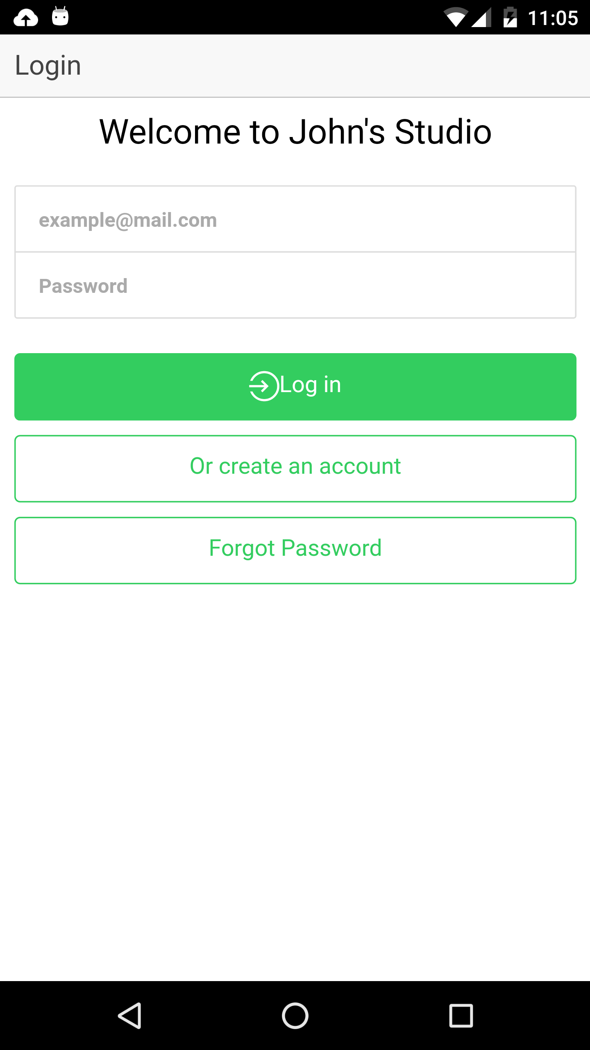
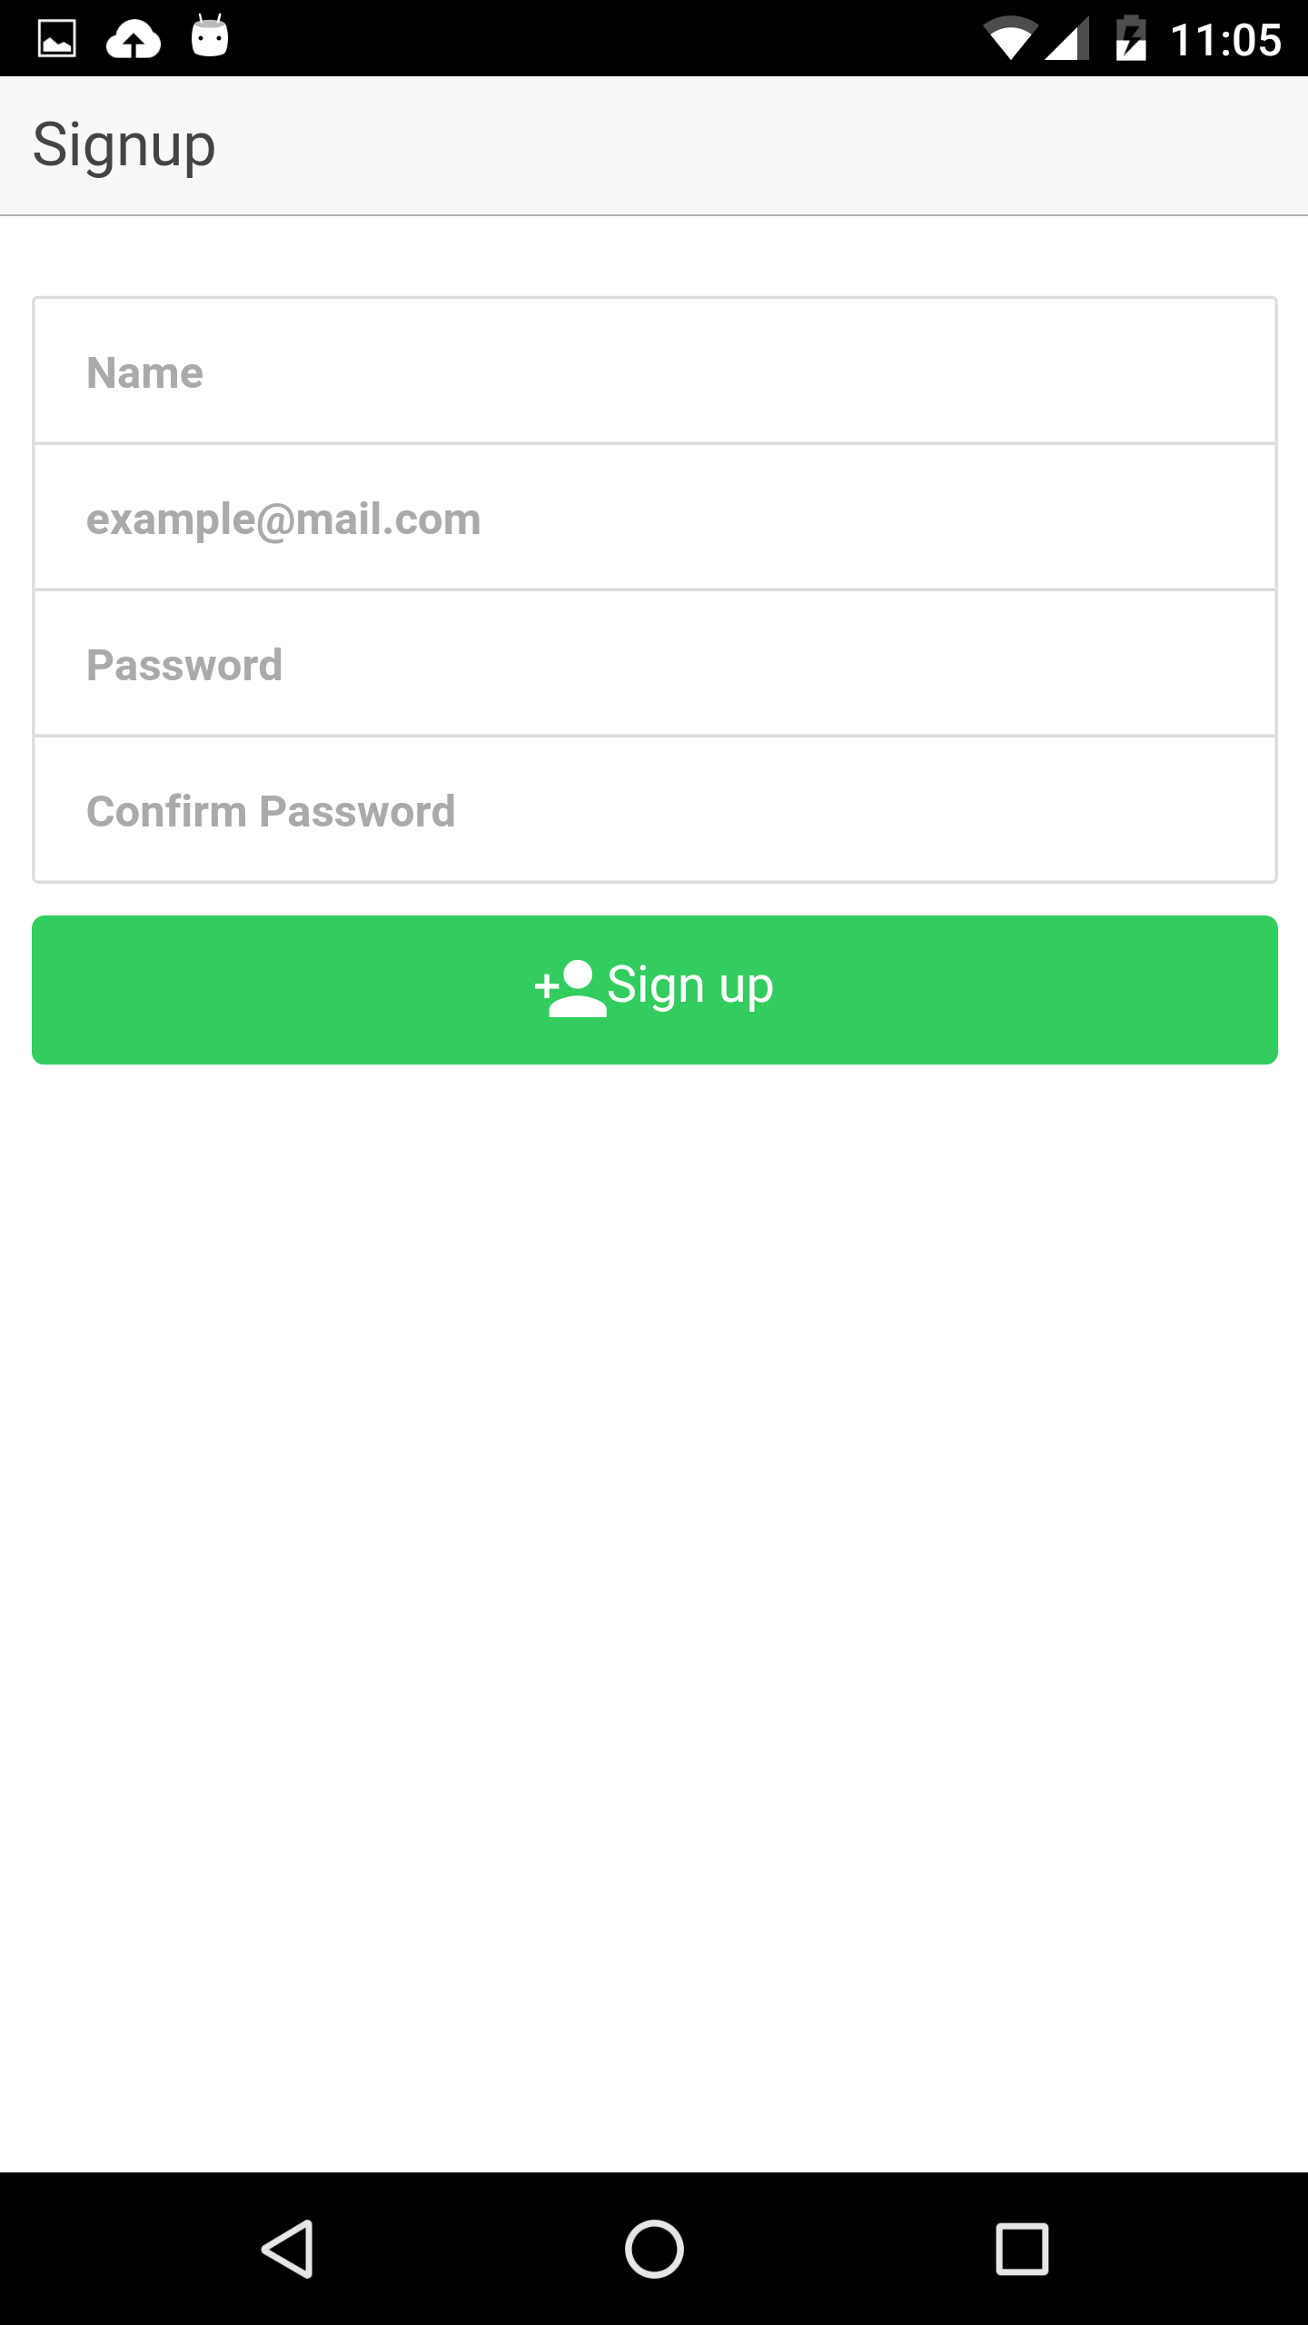
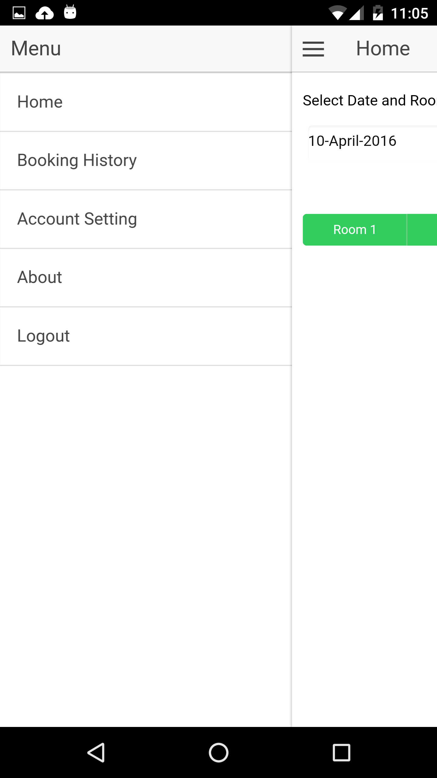

Slide 4
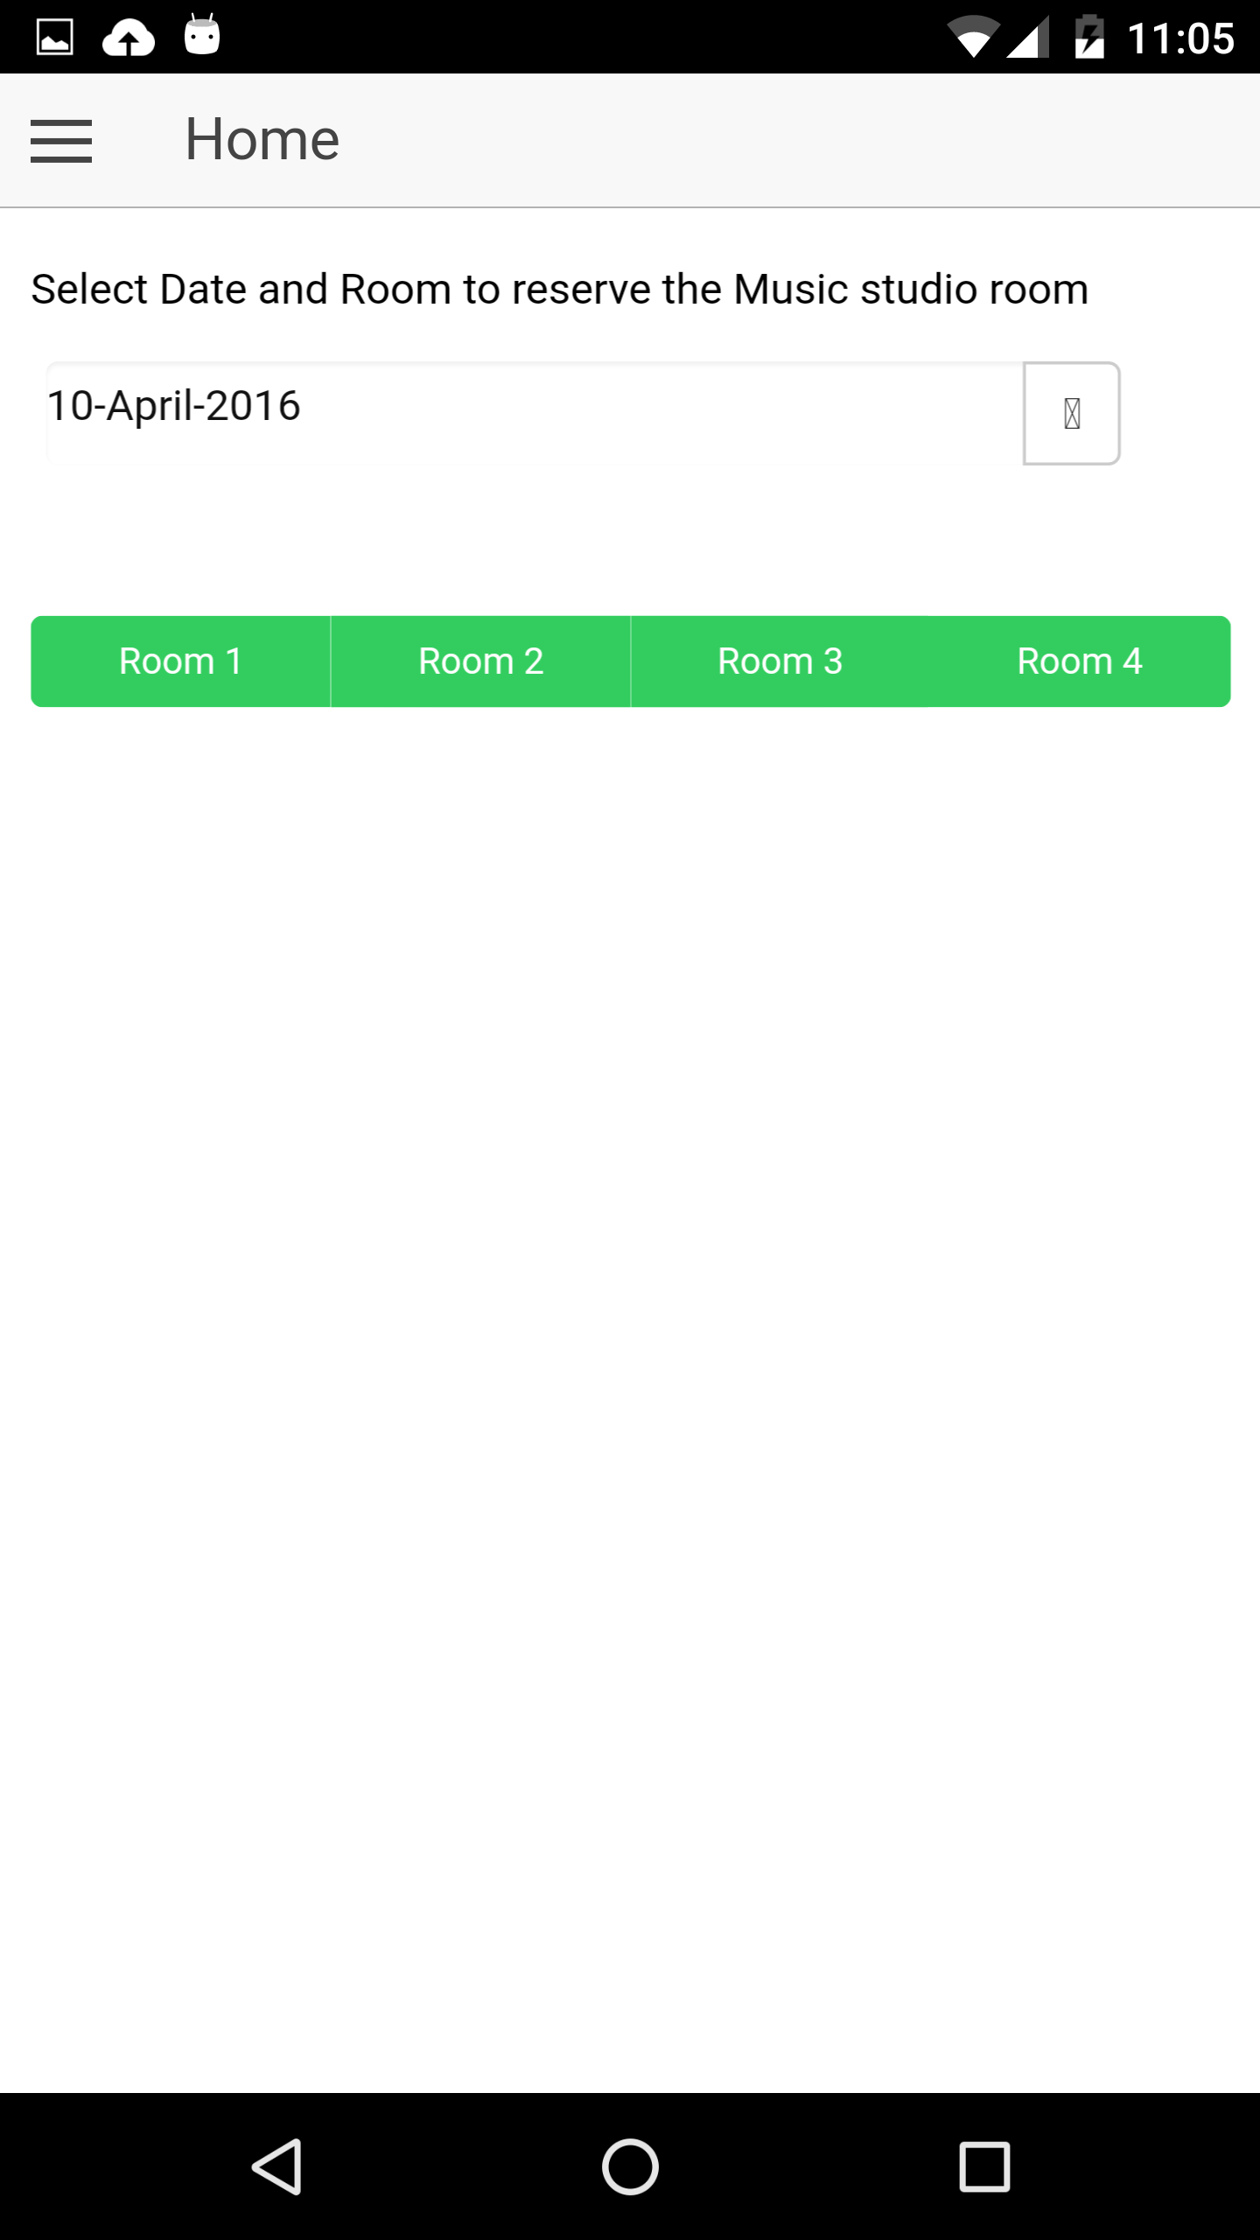
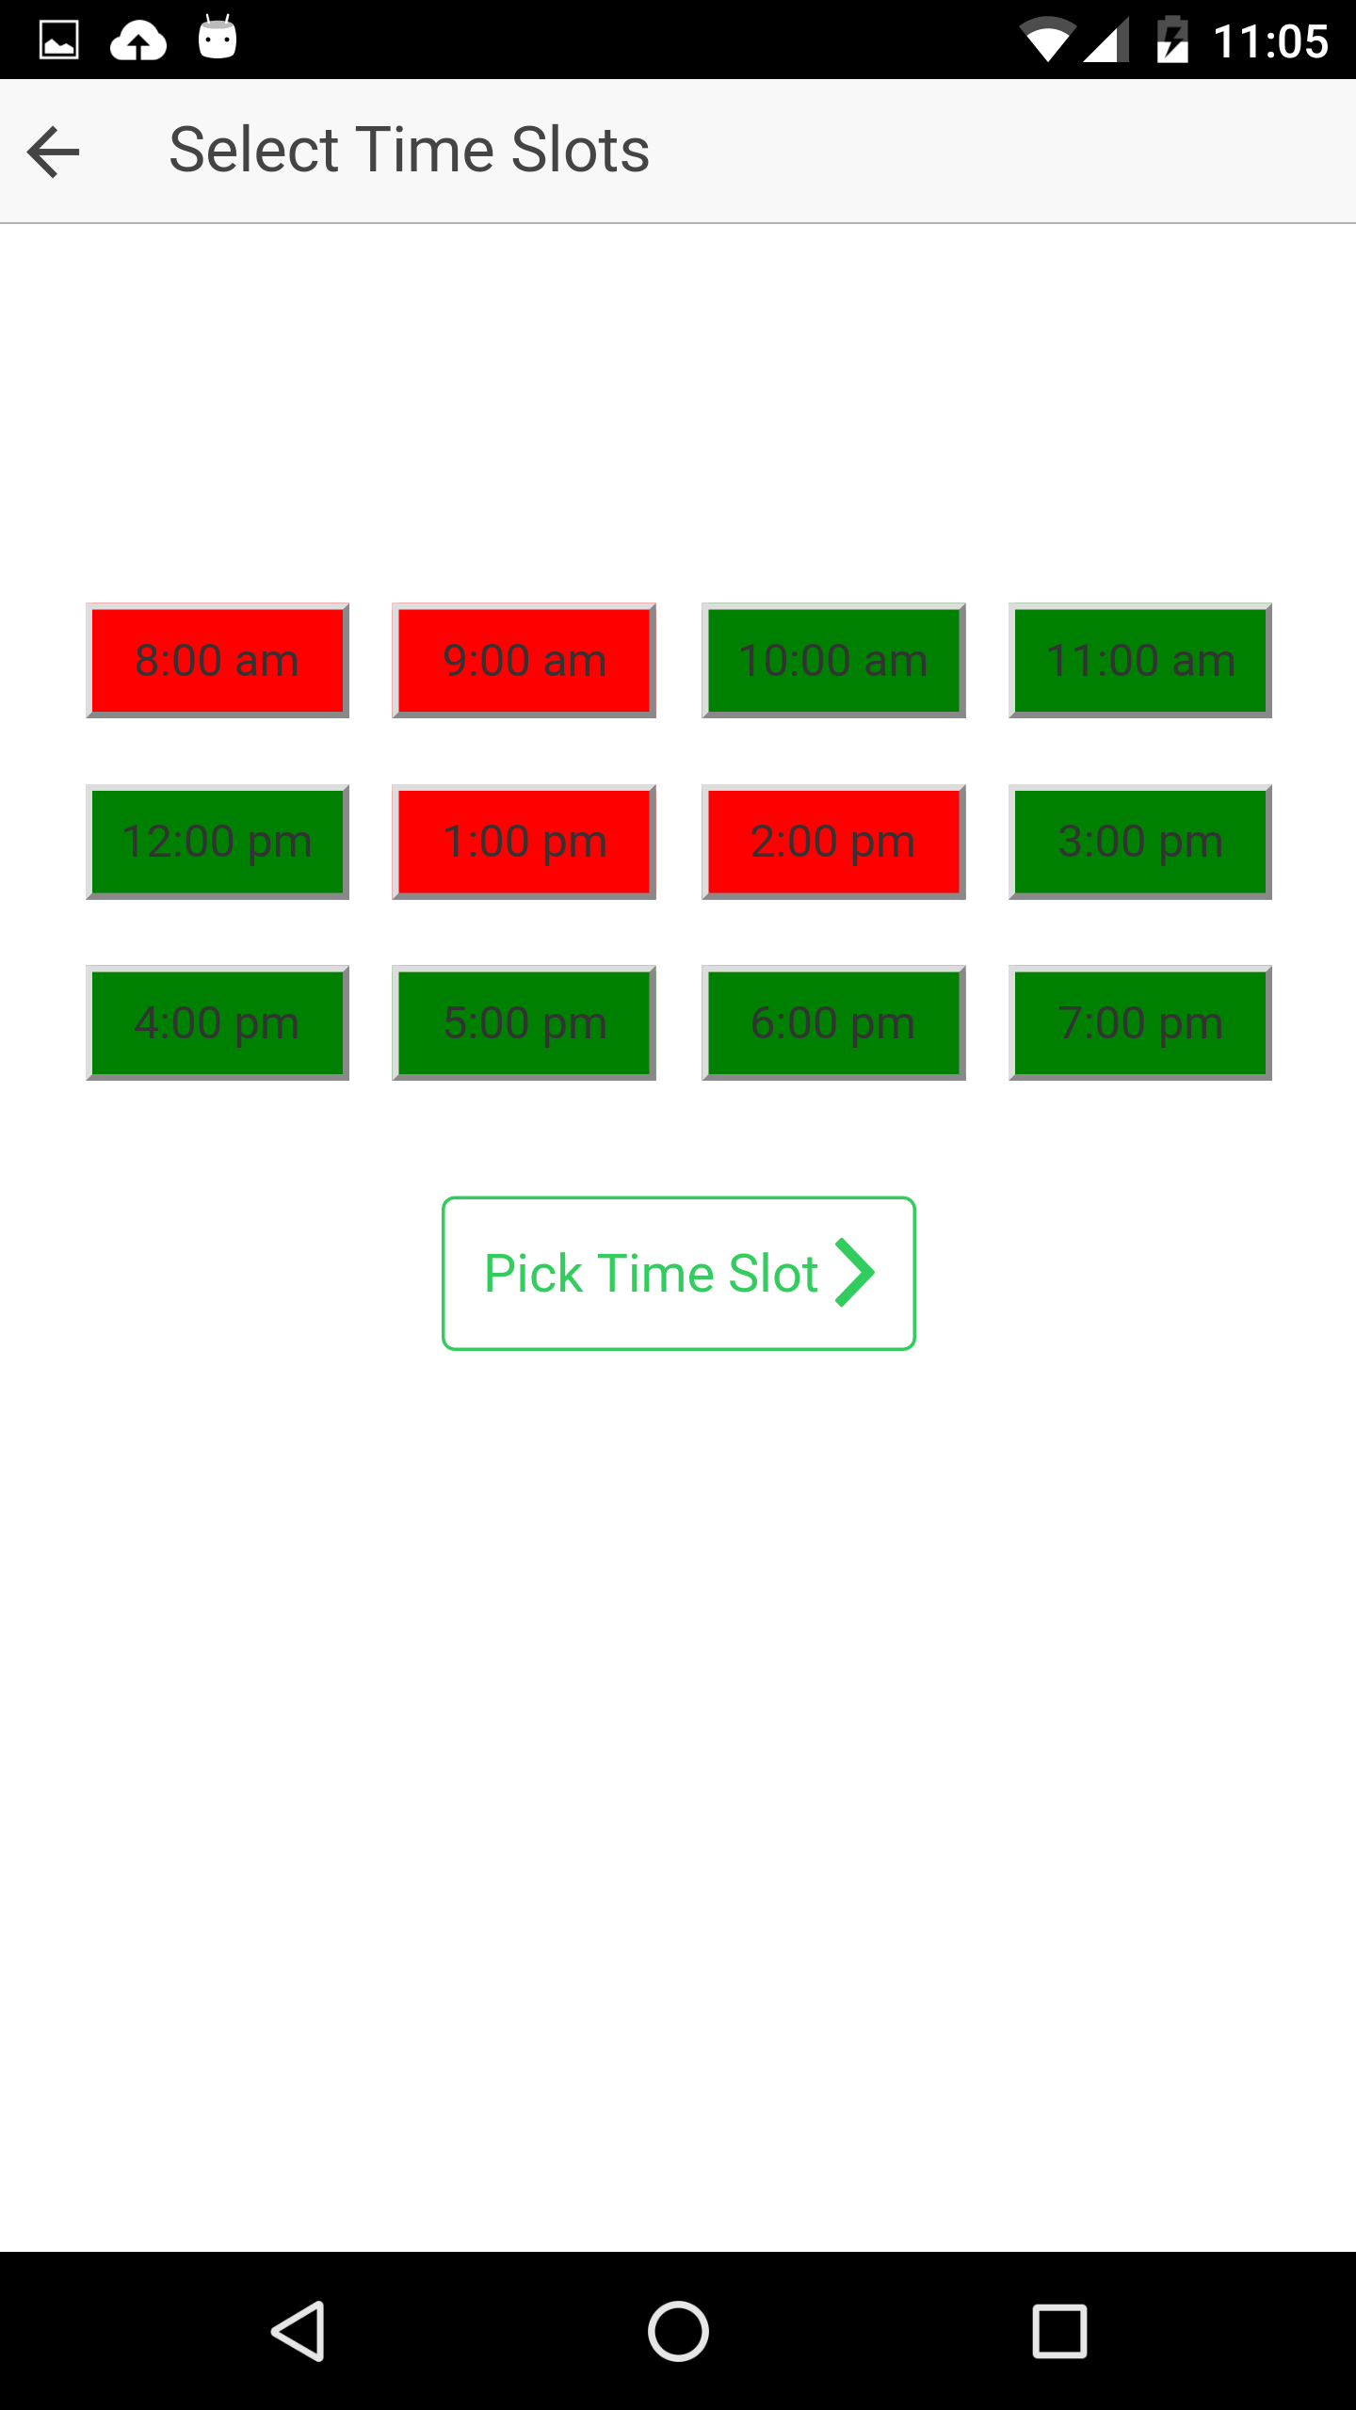
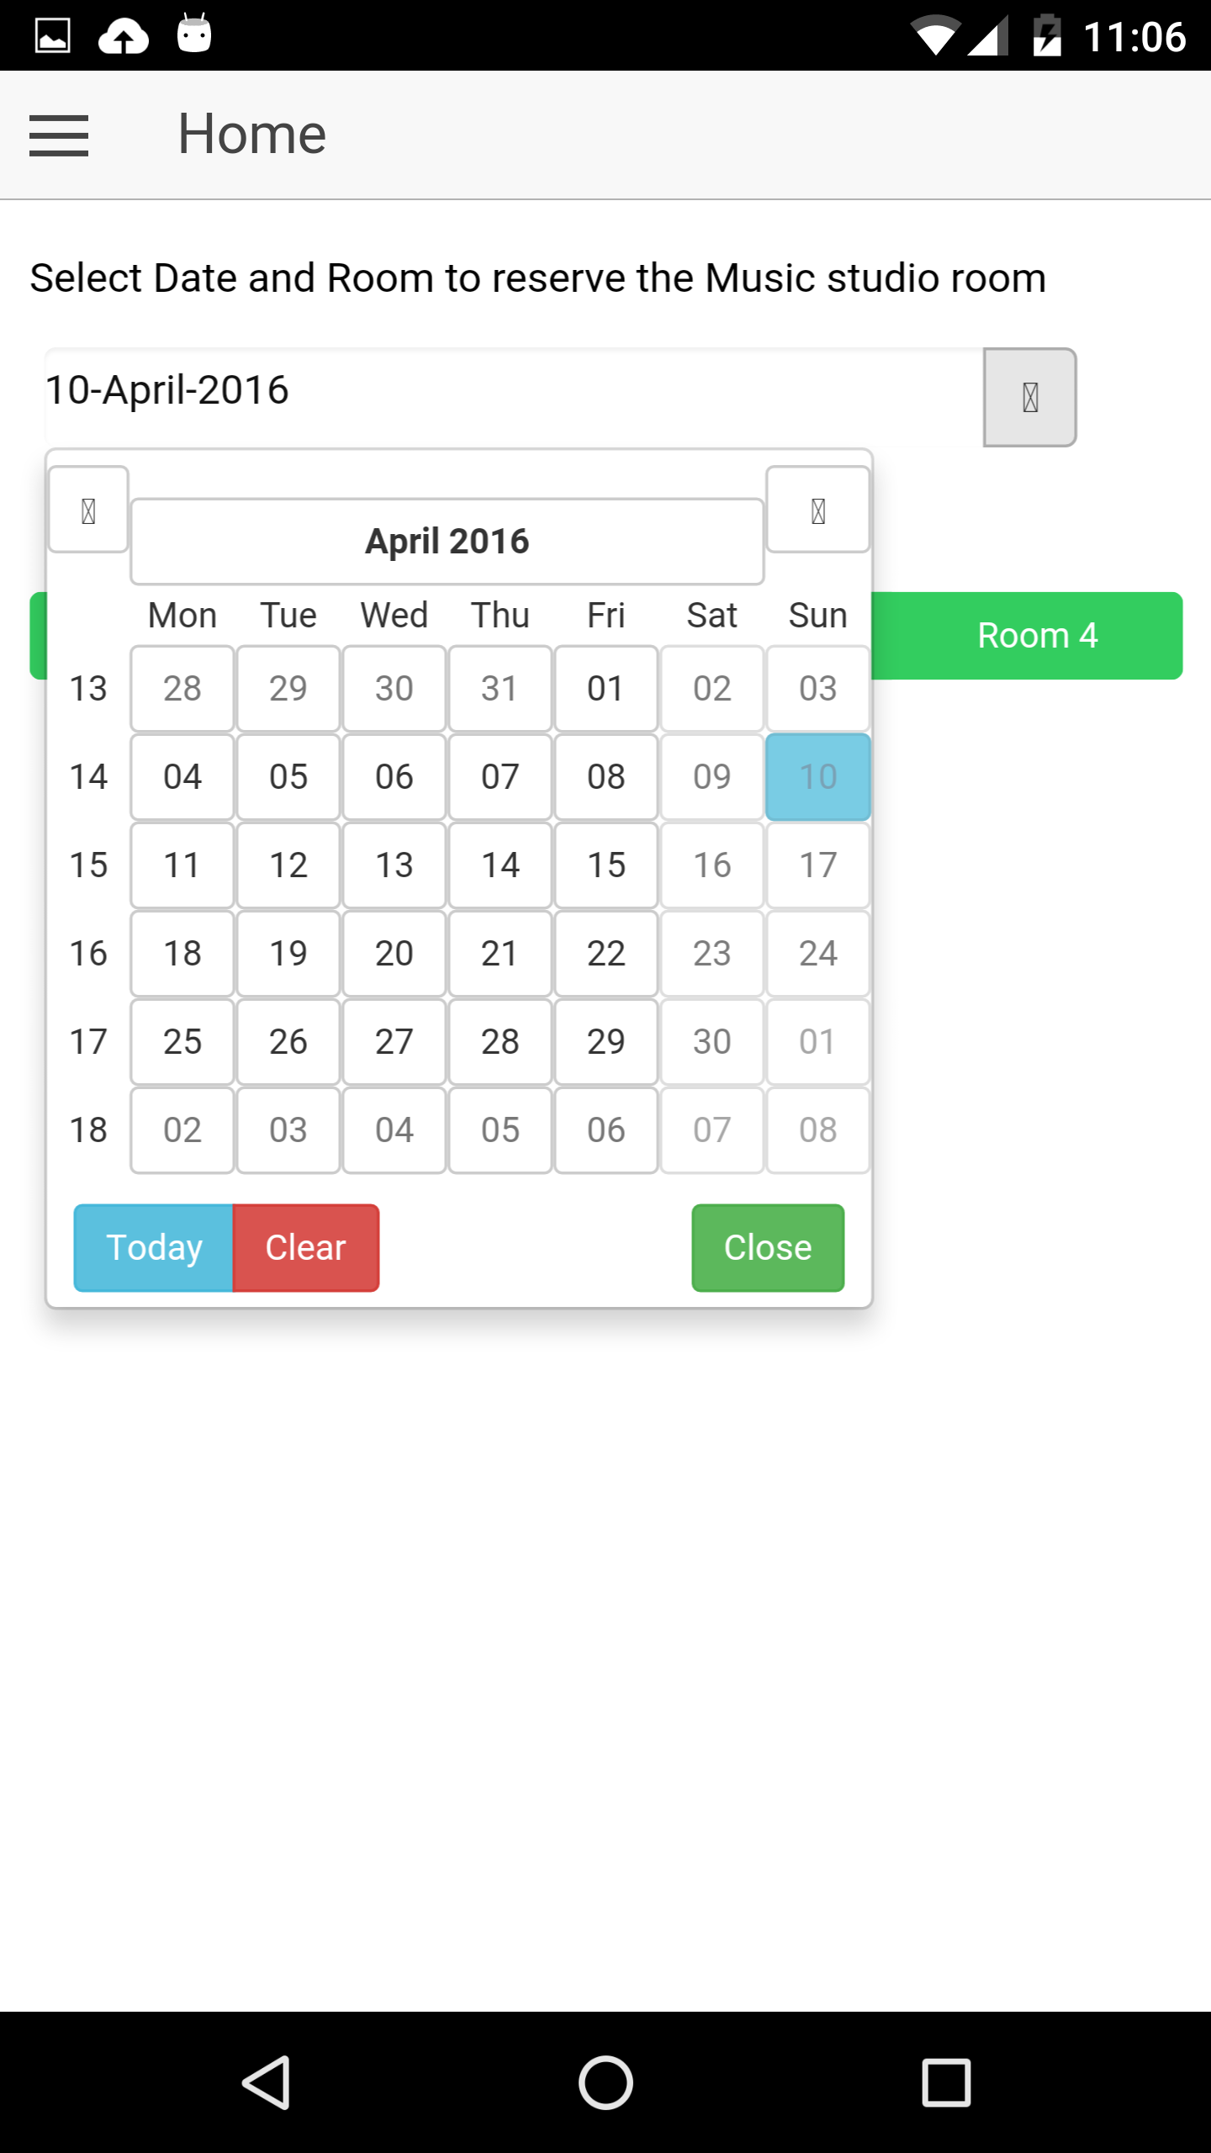

Slide 5
